Slide 1
Why Spirometry
(Chapter1)

Slide 2
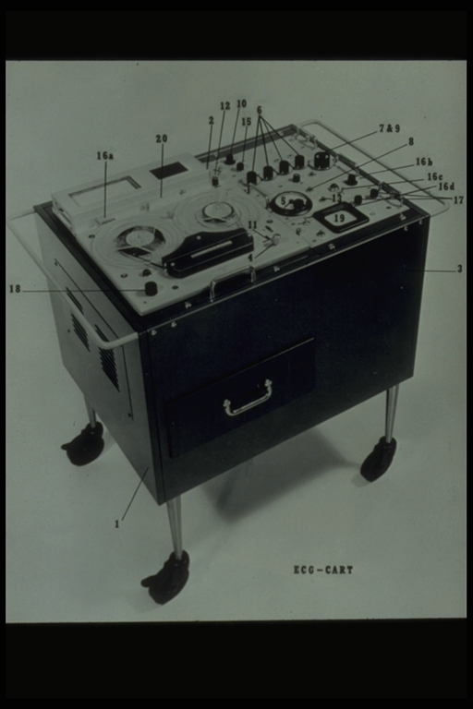

Slide 3
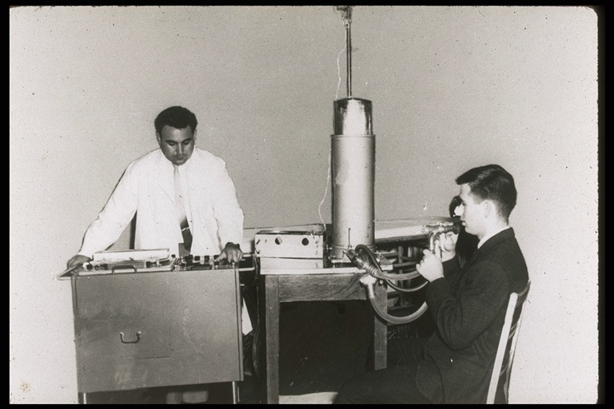

Slide 5
3 Main Measurements
Forced Vital Capacity – FVC
- “Total lung volume”
- Shows Restrictive Lung Patterns
Forced Expiratory Volume in One Second – FEV1
- 1st second of the FVC
- Shows Obstructive Lung Patterns in the Mid/Large
airways
FEV1/FVC% - Ratio
- Shows Obstructive Lung Patterns in the small airways
- We use this measurement to detect EARLY obstructive lung disease” Obstruction starts here.

Slide 6
NIOSH Spirometry Training Program History
1978 OSHA Cotton Dust Standard (29 CFR 1910.1043) requires that NIOSH administer course development of spirometry training within the U. S. cotton textile industry
  - Purpose: improve the quality of occupational spirometry testing by assuring technicians who perform spirometry receive sufficient theoretical and hands-on training
  - Outlines minimum course requirements and course curriculum
Other Federal Regulations that require NIOSH spirometry training
  - 2014 NIOSH Medical Examination of Coal Miners for the MSHA Final Rule
  (42 CFR Part 37)
  - 2016 OSHA Final Rule for Respirable Crystalline Silica (29 CFR 1910.1053)

Slide 7
1978 OSHA Cotton Dust Standard
“The key to reliable pulmonary function testing is the technician’s way of guiding the employee through a series of respiratory maneuvers.
The most important quality of a pulmonary function technician is the motivation to do the very best on every employee.
The technician must also be able to judge the degree of effort and cooperation of the subject.”
From: Preamble to the OSHA Cotton Dust Standard, 29 CFR 1910.1043.
June 23, 1978.

Slide 8

“Test results obtained by the technician who lacks these skills are not only useless, but also convey false information which could be harmful to the employee.”
June 23, 1978
Preamble to the OSHA Cotton Dust Standard, 29 CFR 1910.1043

Slide 9
Course Topics
What is Spirometry?
Why is Spirometry used?
Spirometry test Procedures
Validating Spirometry tests
Interpreting Spirometry tests
Spirometer Types
Program Quality Assurance Techniques
Who Should Receive this Test
Record Keeping
Spirometer Hygiene

Slide 10
Course Objectives
Standardize the test using the six-step method (the script)
Reduce test variability and increase test sensitivity and specificity by the rigorous application of QC procedures
Apply test interpretation criteria
Recognize spirometer types and advantages of each
Understand Record Keeping Requirements
Understand testing Hygiene Requirements
Who should receive spirometry testing

Slide 11
Reasons to Perform Spirometry?
  To detect occupational lung disease
  To detect COPD in adult smokers
  To confirm asthma and its severity
  To measure response to lung medications

Slide 12
Occupational Surveillance and Medical Screening
-Why Spirometry-
Are both prevention measures to help identify workers who are vulnerable to adverse health outcomes due to occupational exposures:
  Identify workers who are at an increased risk of developing disease due to inherited, behavioral, or other host characteristics
  Capture workers with disease but who are not yet diagnosed
  Identify workers suffering biochemical, immunologic, or pathological changes as a result of workplace exposures

Slide 13
Occupational Surveillance
The process of evaluating the workforce due to potential continuing hazards.
  Only group results are reported, not individual results
  Medical screening results come from a defined population of workers
  Results are grouped in relation to the work environment
      Textile workers
      Coal miners
      Firefighters

Slide 14
Medical Screening
Results are based on the individual, not the group
Establishes baseline lung function in a worker
Detects disease in its earliest stages when a change in exposure can be most effective to prevent further reduction in lung function
Its purpose is to decrease suffering and progression of disease

Slide 15
Spirometry and Early Detection
Only spirometry detects lung disease in its early stages when it can be treated
Chest x-rays, symptoms and auscultation only detect advanced, severe lung disease

Slide 16
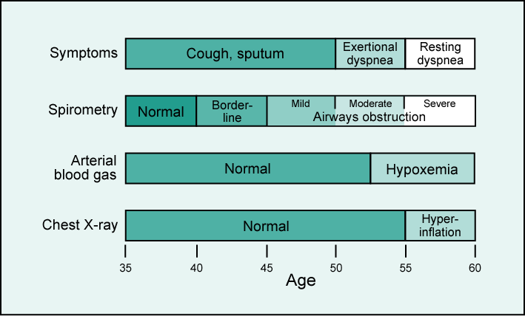
Sensitivity of Diagnostic Tests

Slide 17
Prevalence Rates: US Workers
Obstructive Occupational Lung Diseases
    Byssinosis
      -10% of 300,000 (Ann. Of Intern. Med. 1969)
    Asthma
    -15% due to workplace exposures
(CDC – Weekly - Morbidity and Mortality Weekly Report (MMWR)
May 25, 2012 / 61(20);375-378z0
      COPD
- 6.8% - showed a prevalence of COPD in adults (NHANES111).

Slide 18
Prevalence Rates: US Workers
Restrictive Occupational Lung Diseases
  C W Pneumoconioses (9% of workforce)
  World Socialist Web Site. 01-11-2010 and CDC 64.2011.
  Asbestosis (1.3 million US workers at risk annually)
  Asbestos.com and The Mesothelioma Center, December 5, 2023
  Silicosis ( about 2.3 million workers are exposed annually) https://www.osha.gov/silica-crystalline
  Hypersensitivity pneumonitis- which is the inhalation of animal, vegetable, proteins, and fungis.
  (Studies are not conclusive) % varies by region and exposure.
US National Library of Medicine National Institutes of Health -v .1; 2006 PMC1533805

Slide 19
Risk Management
Identifies, Evaluates and Controls threats to the business enterprise such as:
  Loss of skilled workers due to death or disability from exposures in the workplace
  Increased risk of litigation
  Increased worker comp and health care costs, Restrictive Legislation
  And finally, there is Competition, Fire, Theft and New technology which is part of the definition of Risk Management, but has nothing to do with Spirometry.

Slide 20
Chapter Summary
Spirometry is the only test that detects early obstructive lung disease in its early stages when it can be treated.
Hypersensitivity Pneumonitis - is the
    inhalation of animal and vegetable proteins and fungis.

