Slide 1
Categories of Lung Disease
Chapter 7

Slide 2
Spirometry Classifies Three Types of Lung Disease
Spirometry can identify three classes of lung patterns:
-Obstructive
-Restrictive
-Mixed Impairment
(Obstructive/Restrictive)

Slide 3
Lung Pattern Categories
Obstructive
Obstruction interferes with the flow of
air OUT of the lungs.

Slide 4
Obstruction: Chronic Bronchitis
Cause
  Smoking, Second-Hand Smoke
  Hx of childhood respiratory infections
  Heredity
  Industrial Exposures (So2)
Effect
  Airway inflammation and mucus production
Result in
  Reduced airflow
  Cough, Phlegm, Wheeze & SOB

Slide 6


Slide 8
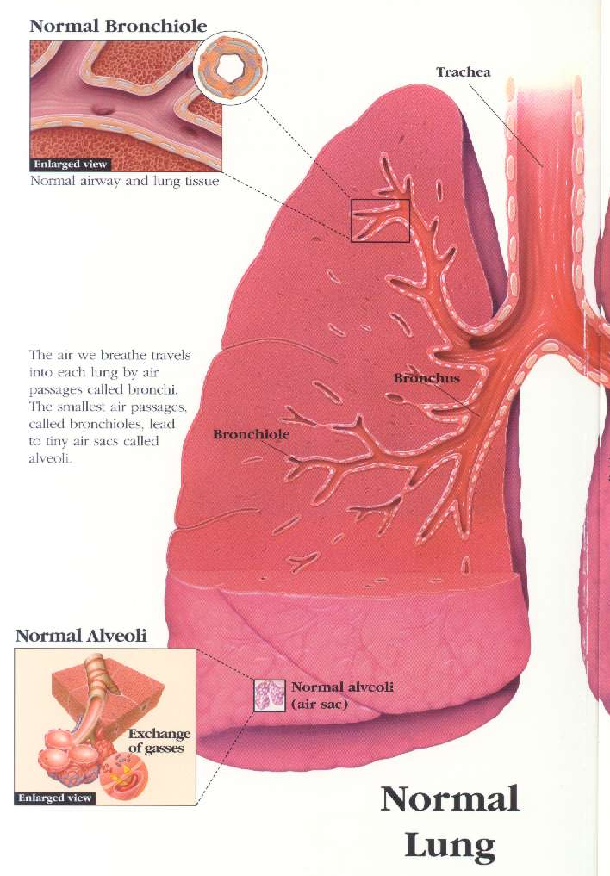

Slide 9
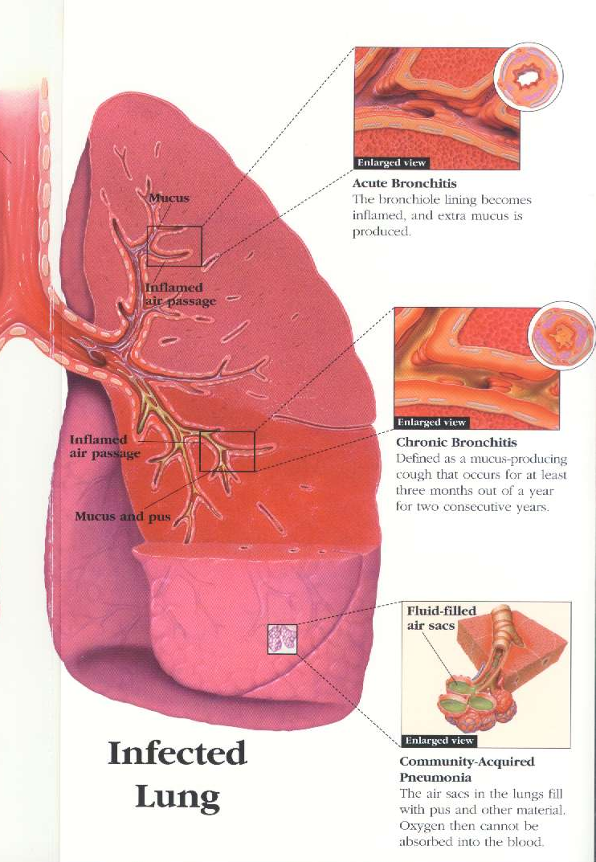

Slide 10
Obstruction: Emphysema
Cause
Smoking, Chemical exposures
Effect
  Airway inflammation and prolonged mucous production
  Loss of Airway Support
  Alveolar Destruction
Result in
  Reduced airflow during exhalation
  Cough, Phlegm, Wheeze & SOB
  Large lungs on X-Ray due to Hyperinflation

Slide 11
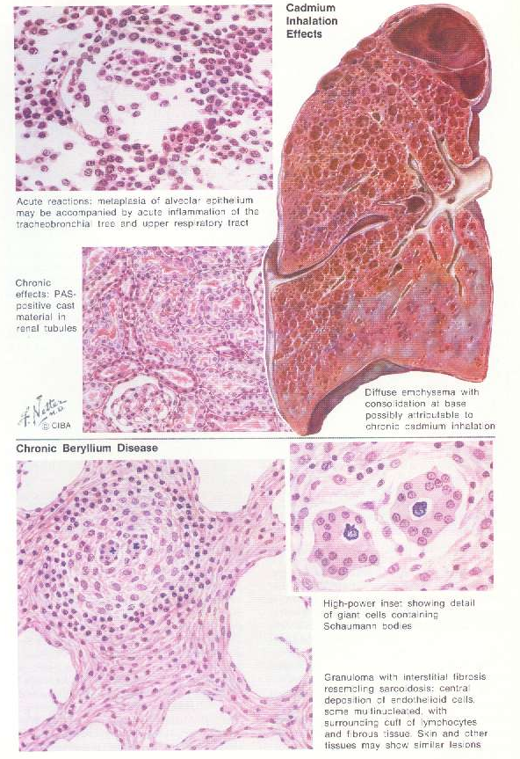
Emphysema due to cadmium exposure

Slide 12
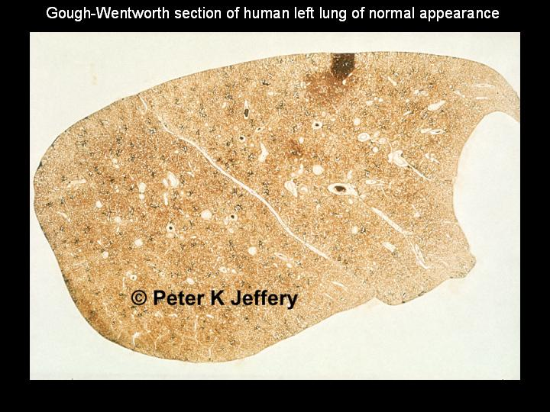

Slide 13
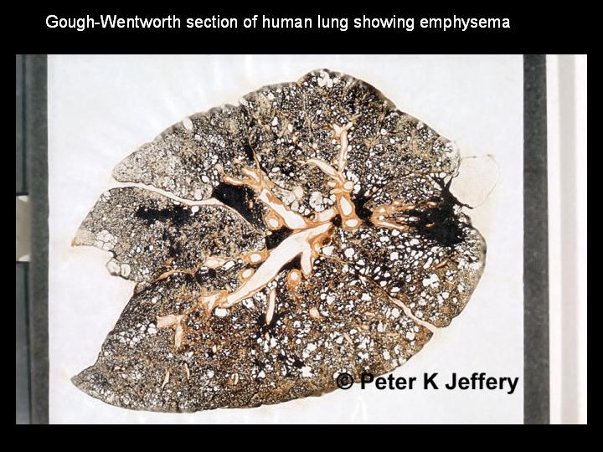

Slide 14
Obstruction: Asthma
Cause
Irritants (chemicals, paints, smoke, cold air, cough & perfumes)
Allergens (food, animal dander, mold, spores, pollens, insects & drugs)
Weather changes
Infection (fungal, viral & bacterial)
Exercise

Slide 15
Obstruction: Asthma
Effect
Airway hyper reactivity:
Thickening of airway walls (inflammation)
Contraction of smooth muscles
Increased mucus secretion
Result in
  Reduced airflow
  Cough, Phlegm, Wheeze & SOB

Slide 16
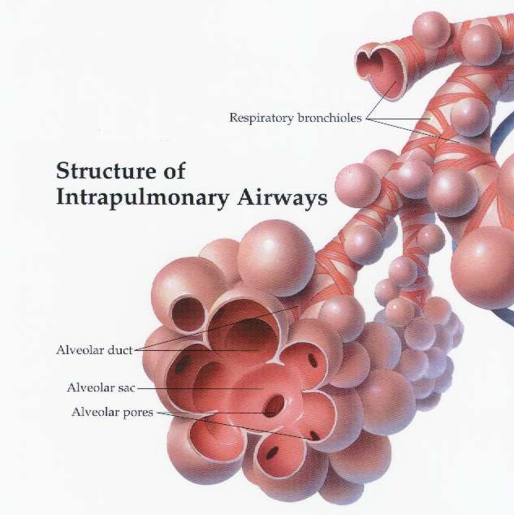

Slide 17
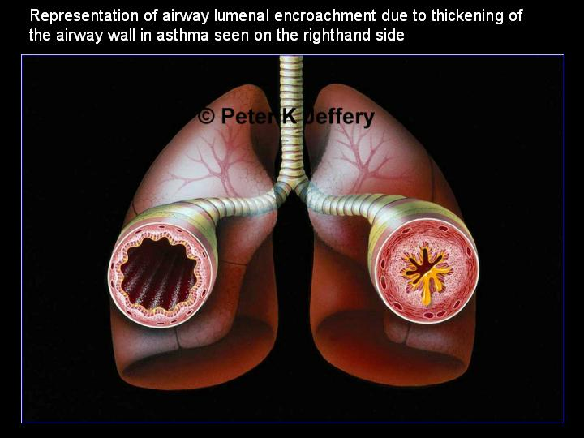

Slide 18
Symptoms Associated with COPD
Although none are sensitive or specific
  Cough or Phlegm – Bronchitis
  Wheeze and Chest Tightness – Asthma
  Progressive SOB – Emphysema

Slide 19
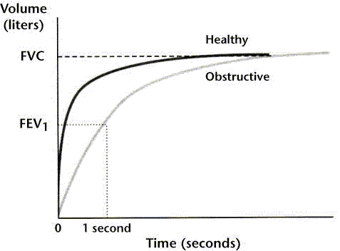
Example of Obstruction on a Volume/Time Curve

Slide 20
Examples of Occupational Obstructive Lung Patterns
  Industrial bronchitis (SO₂)
  Occupationally induced asthma (TDI)
  Byssinosis (Cotton)
  Acute irritant exposures (HCHO)
  Emphysema (Cadmium)

Slide 21
Lung Pattern Categories
Restrictive
Restriction reduces the ability of the lungs to expand resulting in a low FVC value/measurement.

Slide 22
Causes for Restriction
Diffuse parenchymal disease causing intrinsic fibrotic lung disorders (Silicosis, Asbestosis)
Extrinsic Disorders (pleural involvement, obesity, chest wall abnormalities)
Neuromuscular disease (myasthenia gravis)
Excessive particle load & ineffective particle clearance

Slide 27
Effect of Restriction
  Effect
  Reduced lung volumes (primarily FVC)
  Decreased oxygen uptake and SOB
  Opacities on chest X-ray

Slide 28
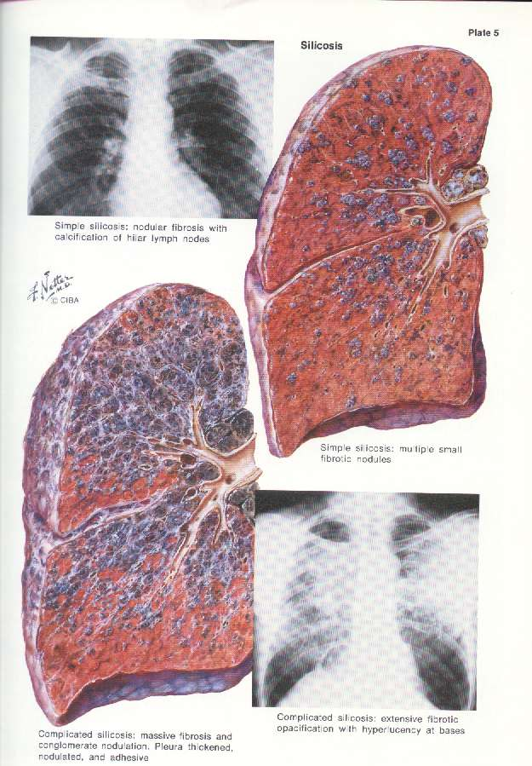
Massive fibrosis due to Silicosis

Slide 29
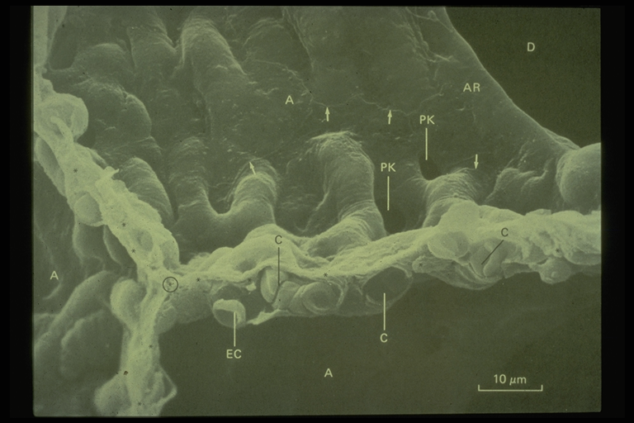
Alveolar double Wall

Slide 30
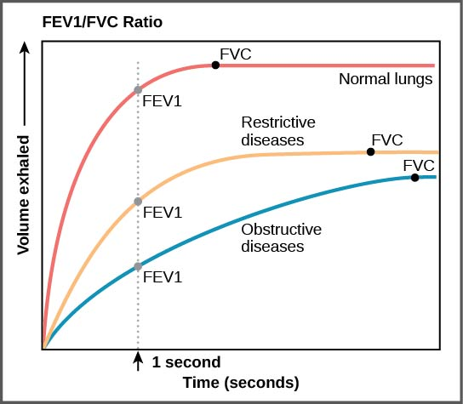
Example of a Restrictive Pattern on a Volume/Time Curve

Slide 31
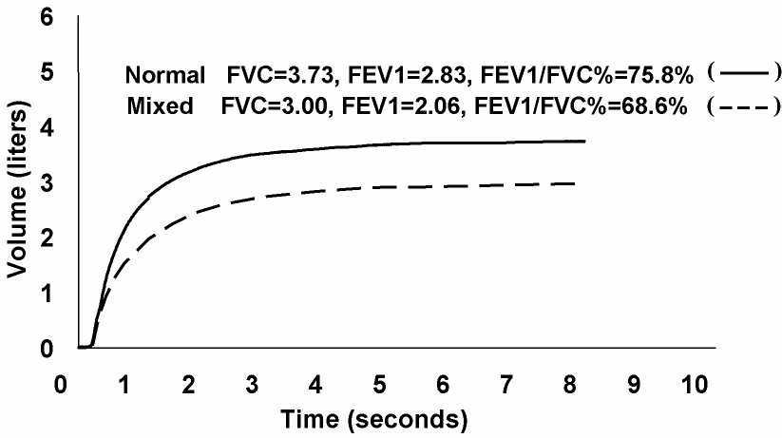
Mixed Impairment
NORMAL AND MIXED PATTERNS

Slide 32
Examples of Occupational Restrictive Lung Diseases
  Coal workers pneumoconiosis
  Silicosis
  Asbestosis
  Hypersensitivity pneumonitis
  Obesity (not a lung disease but can cause a reduction in FVC)

Slide 33
Mixed Impairment
A combination of both obstructive and restrictive impairment.
The FEV₁, FVC, and the FEV₁/FVC% (ratio) will be reduced.
An example of a mixed impairment would be pneumonia (excess fluid displaces air in the lung which would reduce the FVC and there will be excess mucus which will reduce the FEV₁).

Slide 34
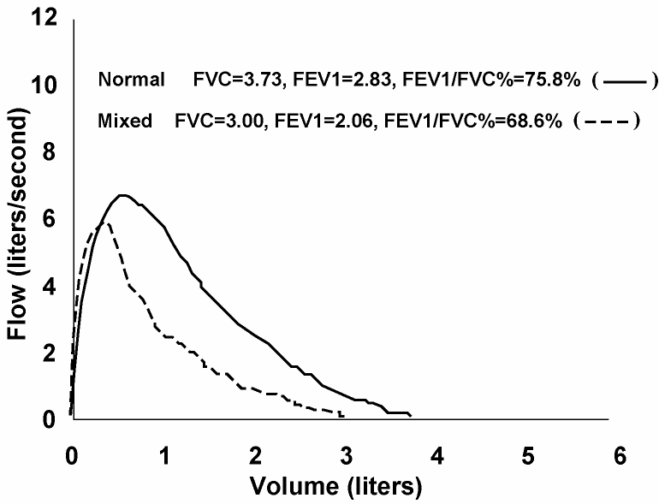
Mixed Impairment
NORMAL AND MIXED PATTERNS

Slide 35
Chapter Summary
Three classes of lung diseases : Obstructive, Restrictive, and a mixed impairment.
. The Ratio measurement is the most sensitive indicator of airway obstruction. Why? Because the ratio will detect the first signs of obstructive lung disease. Obstructive impairment/disease always starts in the small airways. After obstructive disease has been manifested and detected (by a low ratio), which VOLUME measurement do we look at for evaluation of obstructive severity and possible trending?

